Slide 1
LO: To be able to understand how laws are made.
I can explain the work of parliament.
I can explain how the monarchy and parliament work together.
I can explain the process of creating new laws.

Slide 2
Law
What does it mean?
How are they decided?

Slide 3
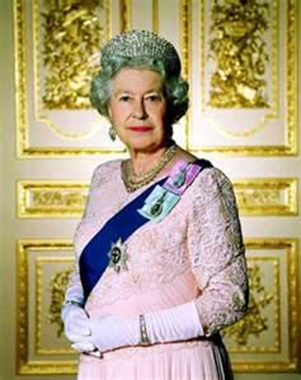
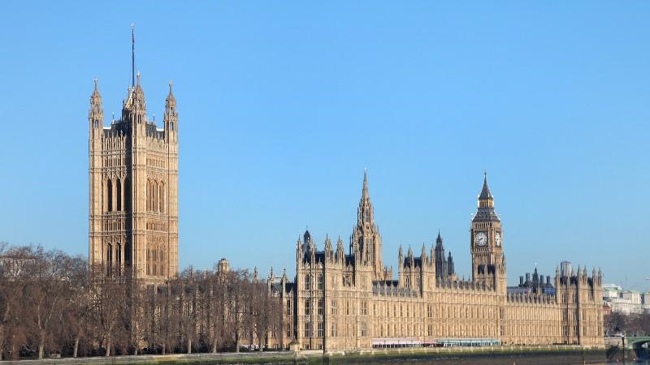
How are these
two things
related?

Slide 4
Makes notes as we go through
https://learning.parliament.uk/en/resources/how-laws-are-made/

Slide 5
Making Laws
What is a law?
What are ideas for new laws called?
Who are they suggested by?
Where is the bill presented?
What happens to the bill then?
What happens when the two houses agree?

Slide 6
Bills can be suggested by: Public inquiries, Political parties, civil servants, campaign groups.
1) Green paper – (proposal) Presents idea.
Discussion with interested parties.
2) White paper (Firm plan after discussion)
3) Cabinet ministers agree whether plan taken forward.
4) Bill made and presented to Parliament.
5) MP’s debate and amend bill
6) Agreed by both house (Lords and Commons)
7) Passed to monarch (king or queen) for approval (Royal assent)
8) Bill becomes law. (act of parliament)

Slide 7
Your task is to create an information page all about how laws are created.
Include as much information from the video as you can.
Make it informative, and try to present it in a creative way.

